Slide 1
Interfacing Seven Segment Display to 8051 Development kit
Engr.Shahzada Fahim Jan

Slide 2
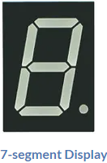
7-segment Display.
The 7-segment display, also written as “seven segment display”, consists of seven LEDs (hence its name) arranged in a rectangular fashion as shown.
Each of the seven LEDs is called a segment because when illuminated the segment forms part of a numerical digit to be displayed.

Slide 3
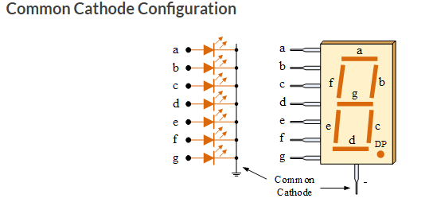
two types of LED 7-segment display called: Common Cathode (CC) and Common Anode (CA).
1. The Common Cathode (CC) – In the common cathode display, all the cathode connections of the LED segments are joined together to logic “0” or ground. The individual segments are illuminated by application of a “HIGH”, or logic “1” signal via a current limiting resistor to forward bias the individual Anode terminals (a-g).

Slide 4
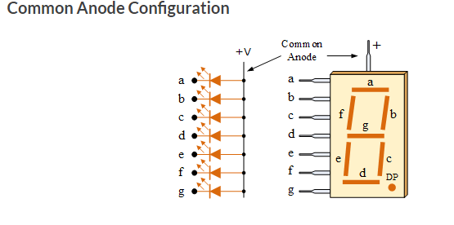
2. The Common Anode (CA) – In the common anode display, all the anode connections of the LED segments are joined together to logic “1”. The individual segments are illuminated by applying a ground, logic “0” or “LOW” signal via a suitable current limiting resistor to the Cathode of the particular segment (a-g).

Slide 5
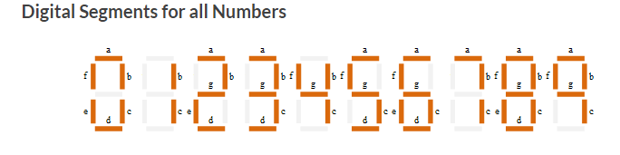

Slide 6
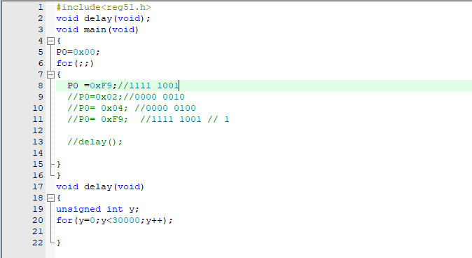

Slide 7
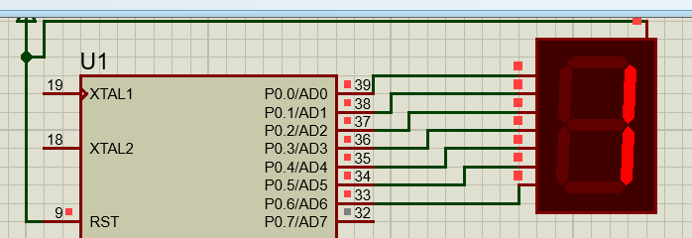

Slide 8
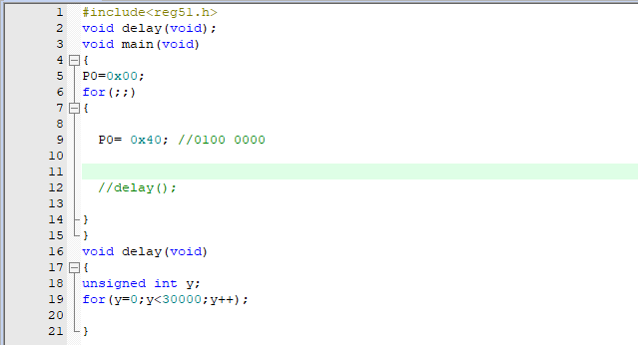

Slide 9
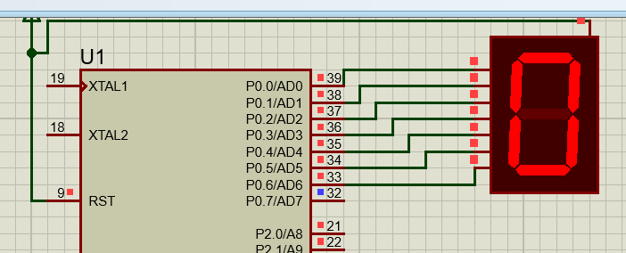

Slide 10
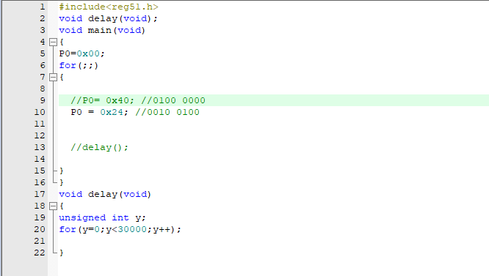

Slide 11
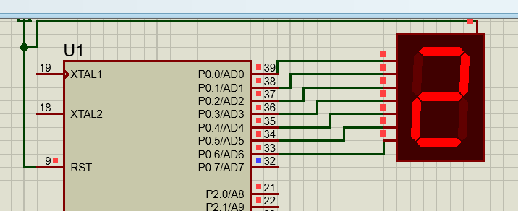

Slide 12
Tasks:
1) Run all the program given in the lecture
2) Display different digits on the Seven Segment Display
3) Display digits from 0 to 9 on Seven Segment Display
Hint: Use 7-segment common Anode

